Slide 1
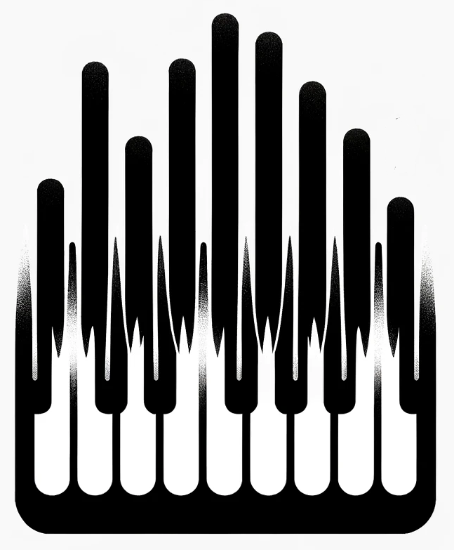
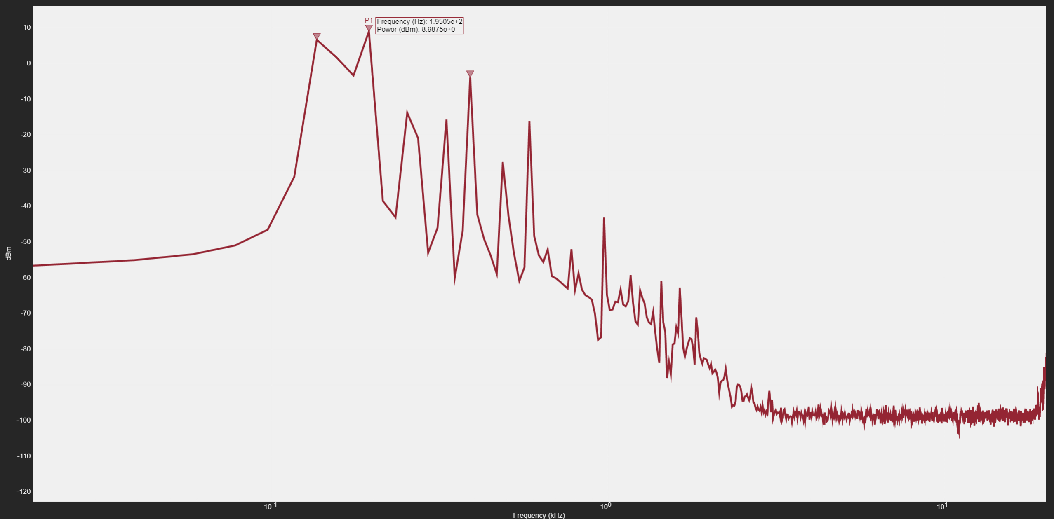
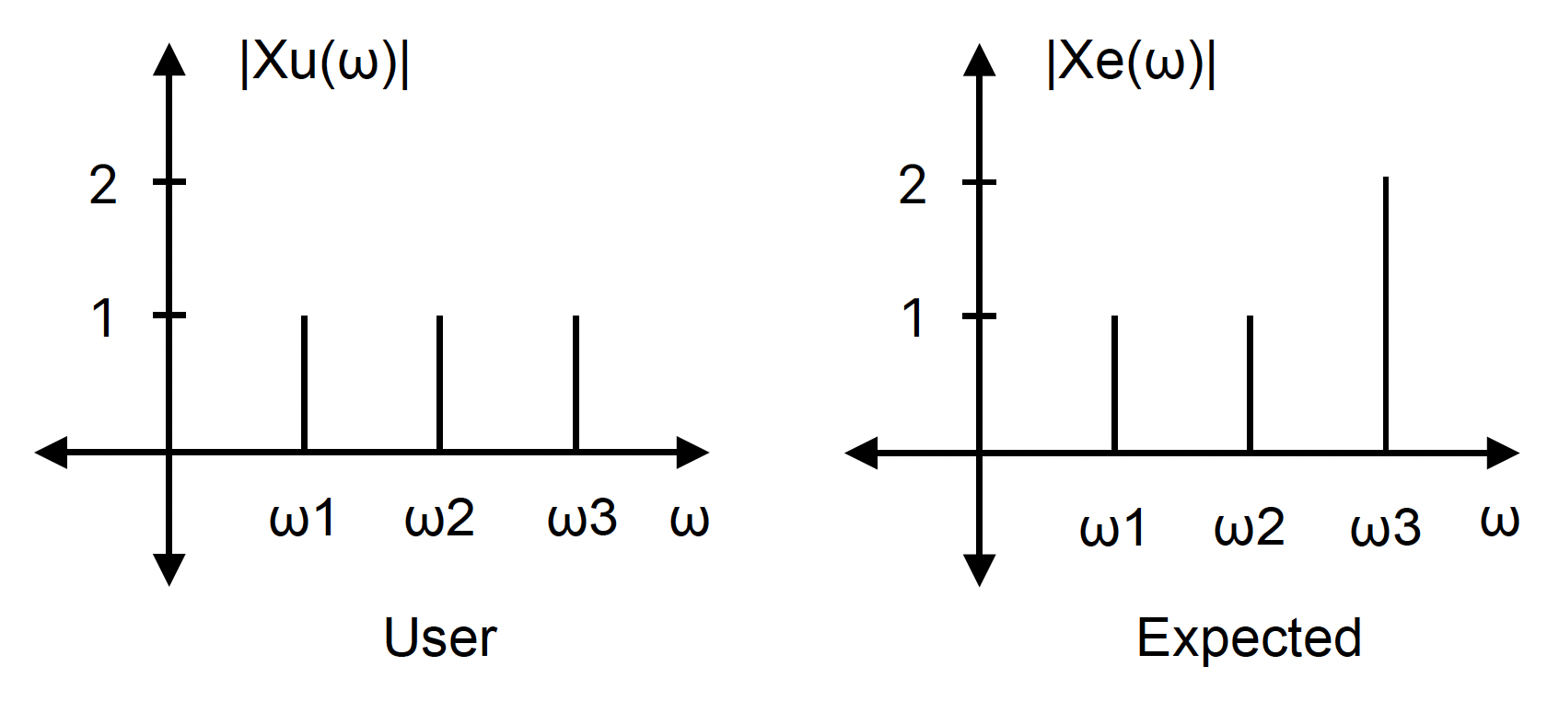
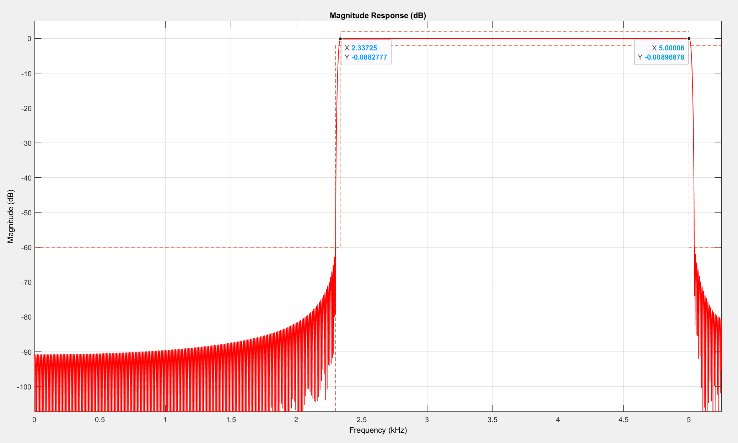
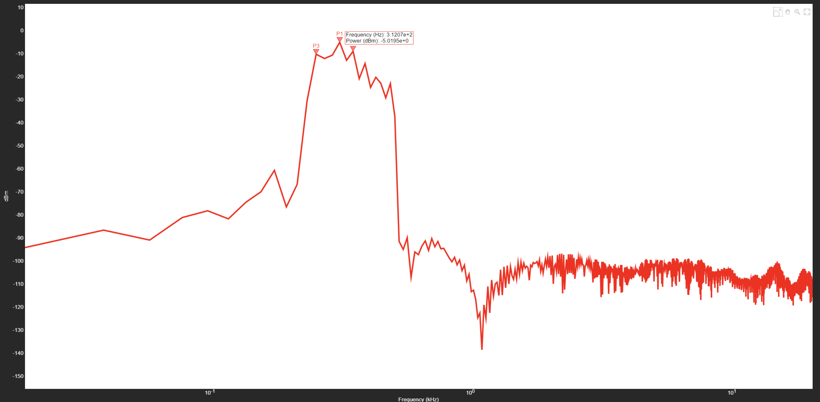
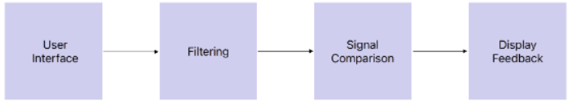
Chord Voicing Feedback
Julian Edelman & Hunter Heath
RCOS
Introduction
Filtering
Signal Comparison
What is Chord Voicing Feedback?
Chord Voicing Feedback is an application that aims to enhance the voicing skills of piano learners by providing real-time feedback on their performance based on dynamics and voicing.
Voicing (Accenting) in out context is relating how emphasis is placed on particular notes within a chord.
The objective is to capture the valuable feedback from a music lesson (such focusing on the pronunciation of melodies and overall voicing) and provide the user with feedback based on those criteria. The application will use exercises of varying difficulty to cultivate these skills.
Objective of Signal Filtering
Our filtering subsystem isolates the fundamental frequencies of piano notes, crucial for accurate pitch perception. By transforming audio into the frequency domain and applying targeted filtering, we lay the groundwork for enhanced signal comparison and user feedback mechanisms in our project.
Objective of Signal Comparison
Once our signal has been filtered and the notes and corresponding amplitudes of the notes have been identified, the chord is now compared to the example chord.
In the figure above, the user signal is the chord that the user will play and the expected is the one that the program wants the user to match. Our program compares the amplitude of the frequencies from the user with the expected and gives a percentage rating of how far off the the user is for each note.
Below we will walk through an example of filtering a
C Major chord which is composed of the following notes:
C4 260Hz, E4 330 Hz, G4391 Hz
Overall Vision
Main Focus
Signal Processing: Enhancing audio clarity with advanced noise reduction and frequency channelization techniques.
Performance Assessment Model: Building an algorithm to compare user voicing to target arrangements.
Secondary Focus
User Interface Design: Crafting an intuitive and efficient user experience.
Web Application Potential: Investigating the transformation of Chord Voicing Feedback into a web-based platform. Domain acquisition and local web interface setup for initial user access.
Development Tools:
Initial Phase: Utilize MATLAB and Simulink for quick prototyping, taking advantage of their signal processing strengths.
Future Vision: Backend Solutions. Leveraging Node.js or Django for backend development, ensuring a strong and scalable server-side foundation for large scale deployment of our program.
Project Foundation
Establishing the groundwork for future web features and enhancements.
Frequency Domain plot of C Major Chord
User vs. Expected Signal:
Each frequency in the user's chord is matched with the corresponding frequency in the expected chord.
Vector Creation: Transform user and expected frequency amplitudes into vectors. The first component is 1, representing the baseline, and the second component is the amplitude value.
Angle Calculation: Determine the angle between the two vectors using the dot product formula. This angle reflects the deviation of the user's chord from the expected chord.
Quality Interpretation: The angle's magnitude informs how close the user's chord is to the target, with quality scores assigned as follows:
-1: Play softer (user signal weaker than target).
0: Perfect match (user signal aligns with target).
1: Play louder (user signal stronger than the target).
Kaiser Window Bandpass Filter from 230Hz to 500Hz
Post Filtering frequency domain plot
Conclusion
Chord Voicing Feedback has laid the groundwork for an innovative tool to assist piano learners. We've taken significant strides in signal processing and comparison, providing a blueprint for intelligent feedback mechanisms. While there's much to accomplish, our commitment to refining this tool promises to contribute meaningfully to the open-source community and musical education.
Filtering Subsystem Summary
Our filtering subsystem pinpoints fundamental piano note frequencies by using a Kaiser window bandpass filter, demonstrating this with a C Major chord example. The process refines the signal, emphasizing key pitches for accurate user feedback. Future development aims to apply this across all 99 piano notes.
Top Level System Design

